Slide 1
Progamming Reflective Video
</
/>
COS10009 Intro to progamming
By: Alison Abuan (102777652)

Slide 2



Topics Covered
Variables
Standard Input/Output
Selection
Loop
Functions

Slide 3
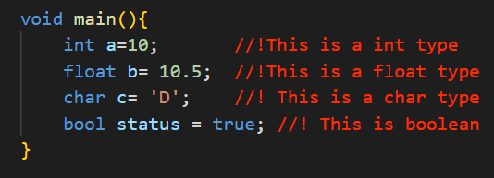
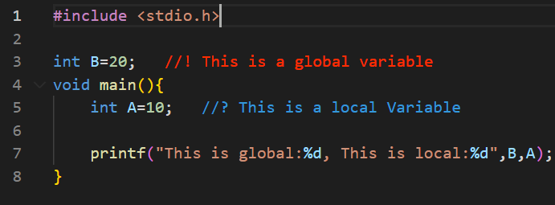
Variables
A variable is a name given to a memory location to store values in a computer program.
It is used to store information that can be referenced and manipulated in a program.
Different types of variable type
Different scops of variable

Slide 4
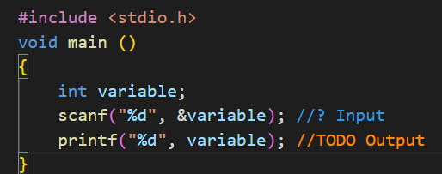
Standard Input/Output
Standard Input (scanf)
Standard Output (printf)
Function scanf has two components
Format specifier
Address operator(&)
Datatype | Format Specifier
Int | %d/%i
Float | %f
Char | %c
Double | %lf
Function printf has two components
Format specifier
Variable (if needed)

Slide 5
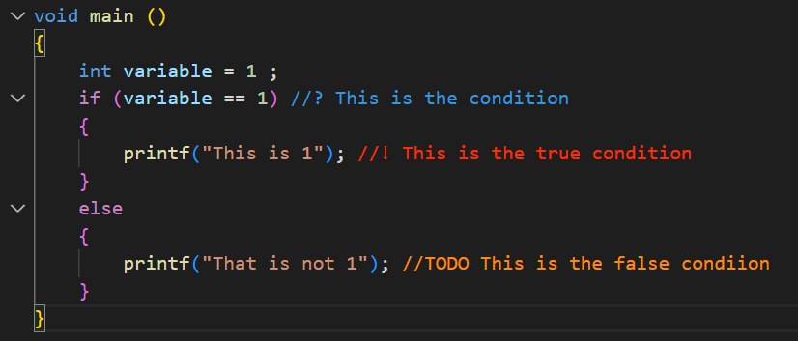
Selection (if else function)
IF condition consist of 3 parts
If condition
Start
If False
If True
The condition
The yes statement
The no statement
Operator | Meaning
> | Greater than
< | Less than
== | Equal to
!= | Not equal to

Slide 6
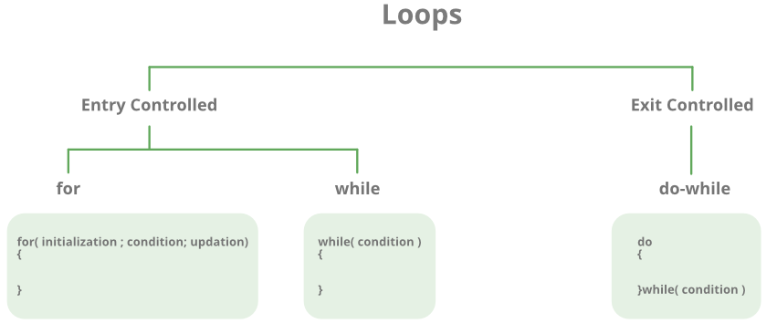
Loops (for,while, do..while)
Loops in programming are used to repeat a block of code until the specified condition is met.
Loop type | Description
For loop | Initializes first → Checks condition→ Executes→Updates
While loop | Initializes → Condition Check → Executes →Updates (inside the loop)
Do while loop | Executes → Checks the condition →Updates inside the loop

Slide 7
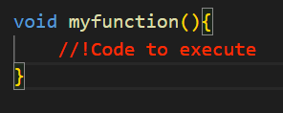

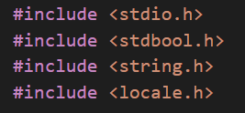
Functions
It is a block of code that runs when it is called. You can pass data known as parameters into a function
Custom functions
Pre-defined functions
Libraries that give access to additional predefined functions

Slide 8
THANK YOU

